Slide 1
Neighbor Relation
Presentation By
Aryan patodiya
Laksh Agarwal
Om Nai

Slide 2
What is neighbor Relation
A neighbor of a solution is another solution that can be reached by making a small modification (or move) to the current solution.
For example:-
In the traveling salesman problem (TSP): A neighbor could be a route obtained by swapping two cities in the current route.
In binary optimization: A neighbor could be a solution obtained by flipping one bit of the binary string.

Slide 3
What are different ways of neighbor relation
IT IS NOT A SPECIFIC ALGORITHM BUT MORE LIKE A FRAMEWORK OR TOOL IN THE APPLICATION OF THE LOCAL SEARCH TO GENRATE NEIGHBOURING SOLUTION.
DETERMINES THE STRUCTURE OF THE NEIGHBORHOOD, WHICH IS SET OF ALL POSSIBLE SOLUTION THAT ARE “CLOSE” TO THE CURRENT SOLUTION.
There are the various forms of neighbor relation defined based on the problem, optimality, requirement, and obviously time complexity matters !!!

Slide 4
A SOFT PRODUCER FOR THE NEIGHBOR RELATION
Generating neighbors: The algorithm uses the neighbor relation to generate new candidate solutions.
Evaluating neighbors: The algorithm evaluates these neighbors using the objective function to decide whether to move to a new solution.
Iterative improvement: The algorithm iteratively moves through the neighborhood, seeking better solutions.

Slide 5
Varied forms of neighbor relation
Swap Neighborhood
Insert/Shift Neighborhood
2-opt or k-opt Neighborhood
Flip Neighborhood
Add/Remove Neighborhood
Permutation Neighborhood
Distance-Based Neighborhood
Hybrid Neighborhoods and many more

Slide 6
Let’s look to few of them

Slide 7
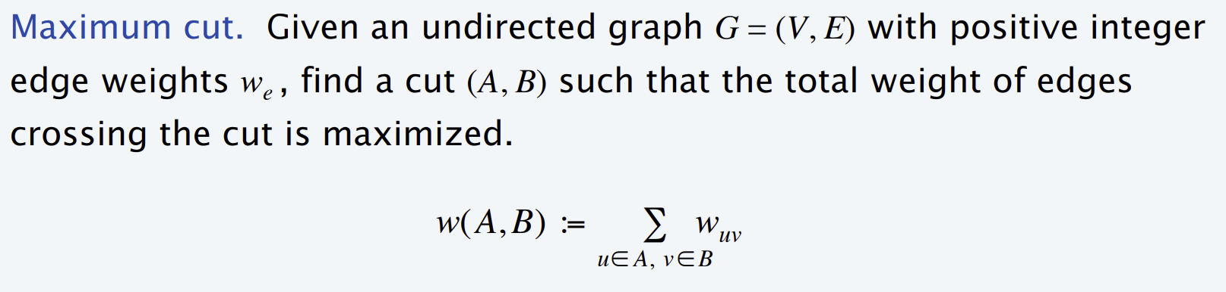
Max CUT Problem

Slide 8
1) Single flip neighborhood or 1 flip neighborhood
Given a cut (A, B), move one node from A to B, or one from B to A if it improves the solution.
OR (IN OTHE WORDS)
Cuts (A, B) and (Aʹ , Bʹ) differ in exactly one node.

Slide 9
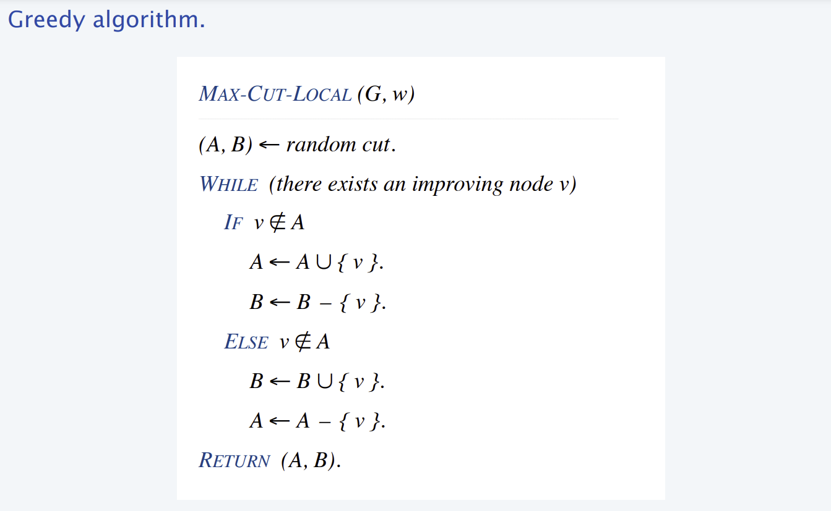
Pseudo code

Slide 10
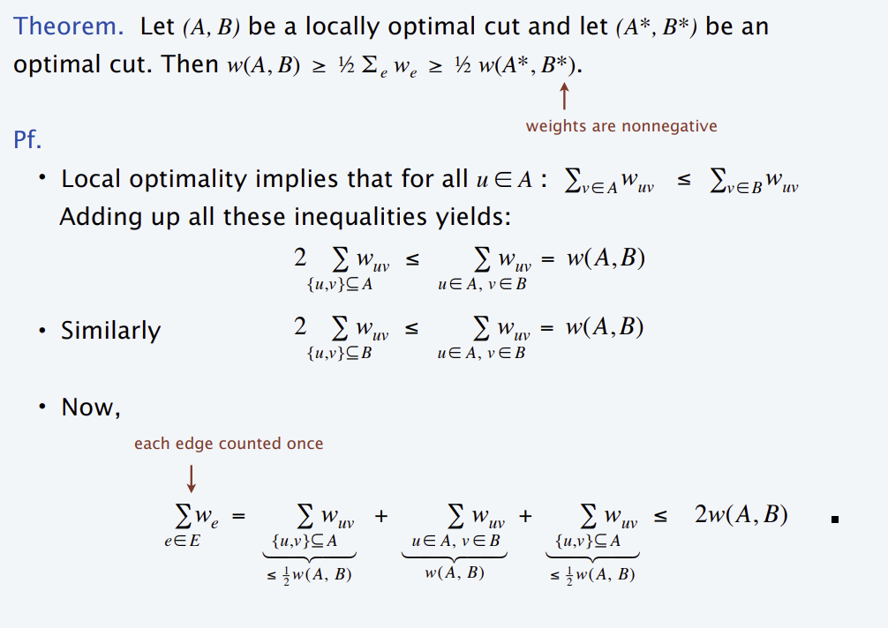
Proof

Slide 11
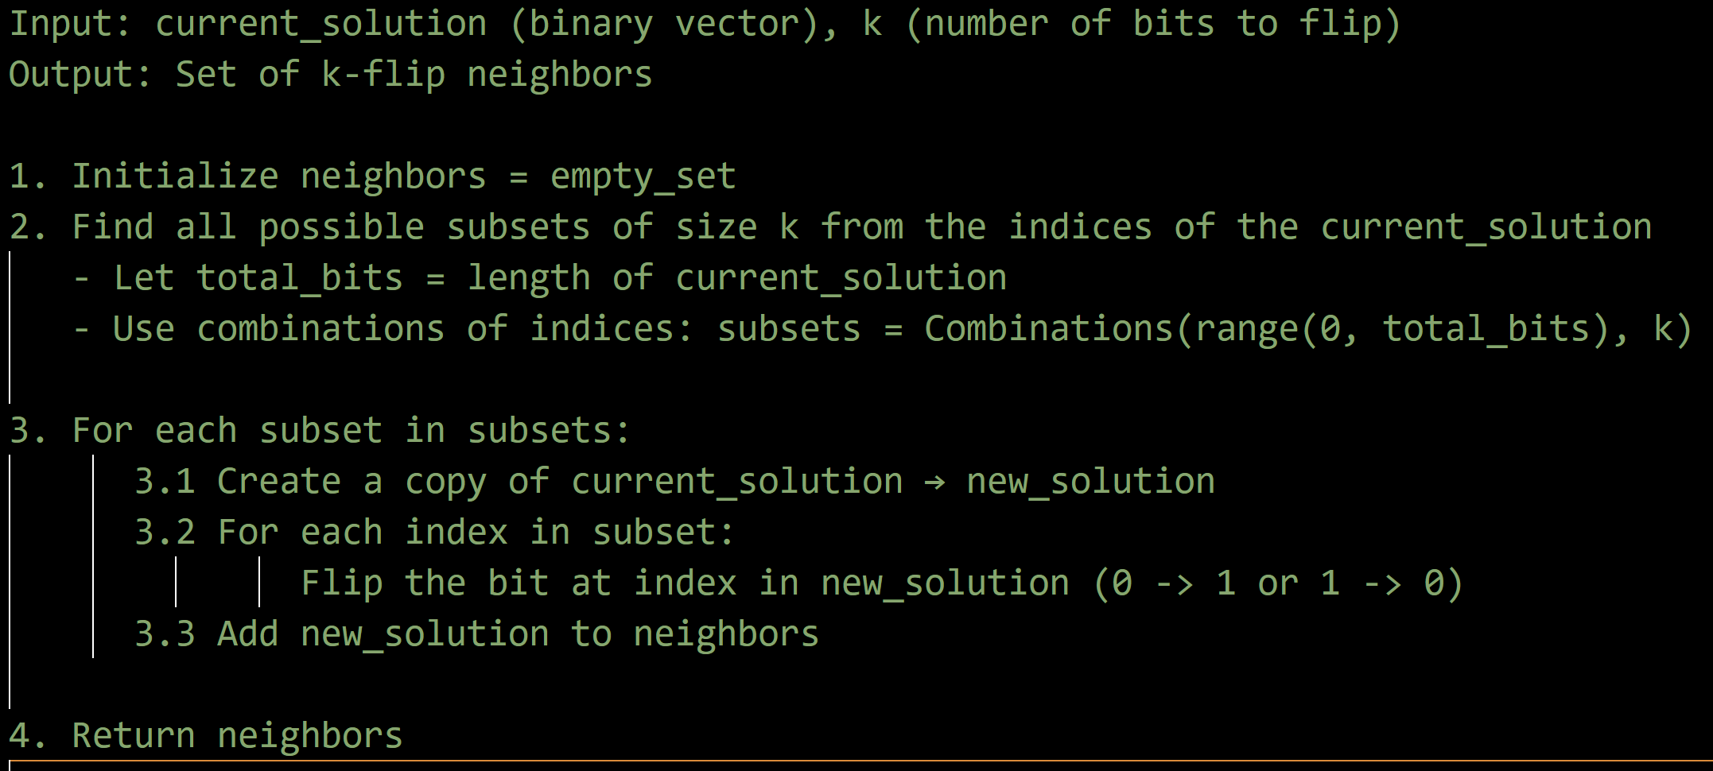
K-Flip Neighbourhood
Cuts (A, B) and (Aʹ , Bʹ) differ in at most k nodes.

Slide 12

Let’s do analysis
Now, we need to flip the k vertices. At some state we are having vertex set of the V.
So, among that V need to flip the k vertices. And the graph also depends upon the E edges so.
O (( $\frac{|V|}{k}$ ) * ( |E| )

Slide 13
Kl Neighbourhood
The Kernighan-Lin (KL) neighborhood is commonly used in solving the Max-Cut problem and other graph partitioning problems. It explores neighborhoods systematically by performing pairwise swaps of vertices between two partitions to improve the cut value. The method was first introduced in the Kernighan-Lin algorithm for graph partitioning.

Slide 14
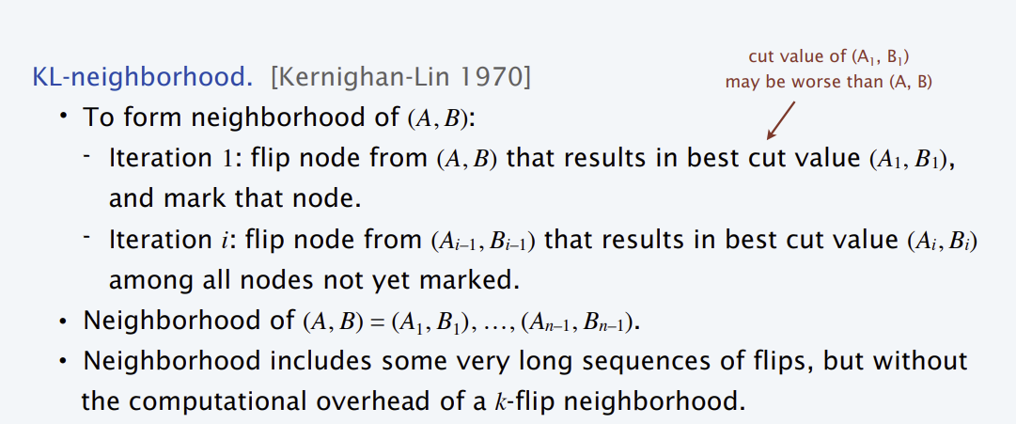
Psudo Code

Slide 15
Let’s See the code

Slide 16
Comparision
Creteria | Single Flip | K-flip | KL-flip
Exploration | Incremental | Broader | Balanced
Efficiency | High(Small) | Low (large k) | Efficient (Large)
Best Use Case | Fine-tuning | Escaping local optima | Constrained problems or subset exploration

Slide 17
Refrences
Wikipedia
Princeton.
GFG
Simplilearn
Scaler

Slide 18
Thank You

